Slide 1
Microservices

Slide 2
Microservices
Microservices is an architecture that helps build an application as a collection of loosly coupled and independantly managable services.
It is best suitable for applications which can be broken down into smaller, composable pieces which can work together.

Slide 3
Monolethic Vs Microservice
In monolithic architecture all the components of an application are developed together and tightly coupled.
Following are the drawbacks of the monolithic architecture.
1. They are inflexible as you can not use different technologies.
2. They are not fault tolarent as if one component fails, the entire application fails.

Slide 4
Monolethic Vs Microservice
Following are the drawbacks of the monolithic architecture......continued
3. They are not scalable as a specific component of the application can not be upgraded, enire application needs to be upgraded.
4. These types of application development process is slow, As sequential development approach is required.
5.They do not allow continuous development, as individual features can not be seperately build and tested.
These problems led to the concept of microservices.

Slide 5
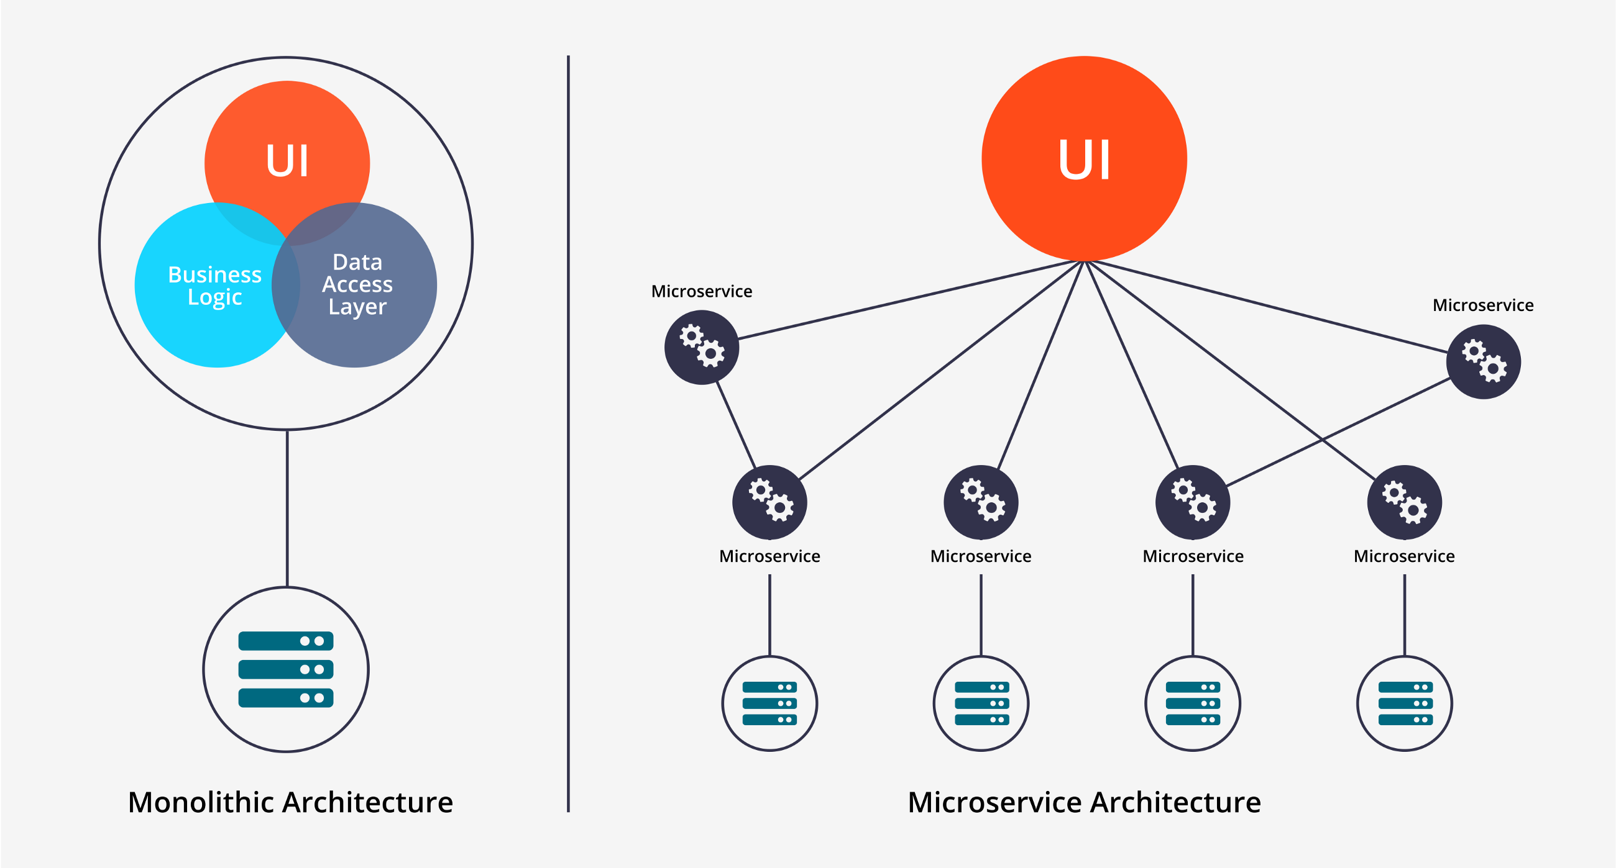
Monolethic Vs Microservice

Slide 6
Microservices
Microservices as they are a set of modular components are easier to understand, easier to develop, easier to test and easier to maintain over the entire lifetime.
They provide a much higher agility and thus reduce the time required to develop the application.

Slide 7
Microservices
The microservices provide following benefits.
1. Small teams can work in parallel and develop services faster.
2. If one of the components fails, you can start another instance of that component while other components continue to work.
3. Resource allocation becomes easier. Only required components can be scaled to meet the increasing load demands.

Slide 8
Microservices
Each microservice has its own load balancer and execution environment and mostly has its own database.
These microservices identify the other services using service discovery.
These microservices communicate with each other using a stateless server using REST or Message bus

Slide 9
Microservice Architecture

Slide 10
Microservice Architecture
The management component is responsible for deploying services on nodes, scaling services as per load requirements, detecting failures, rebalancing services across other nodes.
The service discovery component maintains a list of services and the nodes that are hosting these services. They provide endpoints to connect to these services.

Slide 11
Microservice Architecture
The API gateway provides the connection point for the clients.
The API gateway forwards the call to the aprropriate service on the back end.
The API gateway may combine the response from diferrent services and return an aggregate response to the client.

Slide 12
Microservice Architecture
The API gateway decouples the client from the services.
This helps easy management of services in the background without having to update the clients.
API gateways can often provide other functions like authentication, load balancing and logging.

Slide 13
Microservices deployment patterns
1. Single Service Instances per Host
Traditional Approach
Each service instance executes on its own server/host.
Provides isolation between each service instances.
No conflicting resource requirements or version dependancy.
Less efficient and costly.

Slide 14
Microservices deployment patterns
2. Multiple Service Instances per Host
Multiple service instance executes on single server/host.
efficient resource utilization and less costly.
Need techniques to provide isolation between each service instances. (Not possible also)
conflicting resource requirements or version dependancy may occur.

Slide 15
Microservices deployment patterns
3. Service Instances per VM
Each service is packaged as a virtual machine image and executed on an independant VM.
efficient resource utilization and less costly.
Provides isolation between each service instances.
No conflicting resource requirements or version dependancy.
Easy Scaling (Add more VM's)
Deploying VM is slow and managing VM's is a time consuming.

Slide 16
Microservices deployment patterns
4. Service Instances per Container
Each service instance executes on single container.
Each service is packaged as a container image and executed on an independant container.
efficient resource utilization and less costly than VM approach.
Provides isolation between each service instances.
No conflicting resource requirements or version dependancy.
Easy and fast scaling (Faster than Deploying VM)
New Technology as compared to Hypervisor.

Slide 17
API Gateway
Direct Client to Microservice communication

Slide 18
API Gateway
Direct Client to Microservice communication
In this method each microservice gets an public endpoint(URL).
Each microservice may get a different port number.
A production environment may use a load balancer and or Application Delivery Controller.

Slide 19
API Gateway
Direct Client to Microservice communication
This approach is suitable for small micro service based application.
Client app requires services from multiple backend microservices, thus client needs to call different endpoints frequently.
This increases the round trip between client and server. (Increases Latency)

Slide 20
API Gateway
Direct Client to Microservice communication
Need to update client for each new microservice introduced. (Clients tightly coupled)
Microservices need to be exposed directly to the internet. (More prone to attacks)
Microservices should perform authentication, SSL and logging. (Increased overheads)

Slide 21
API Gateway

Slide 22
API Gateway
The API gateway is the solution to the earlier problems in the client to microservices direct communication.
The API gateway may handle multiple different client applications.
To avoid bottleneck due to gatway, it is recommended to split the gateway into multiple service level gateways.

Slide 23
API Gateway

Slide 24
API Gateway
If the application has multiple client side applications, that can be a deciding factor in implementing a gateway.
Thus each gatway suffice the needs of each client application.
This Gateway implementation is known as 'Backend for Frontend(BFF)'.

Slide 25
API Gateway
The API Gateway may provide following features.
Reverse proxy - the gateway provides a single end point or URL to the client apps and then internally maps the calls to internal microservices.
This helps manage the microservices independantly of client apps. (Adding/removing/shifting of microservices)

Slide 26
API Gateway
The API gateway may aggregate response for multiple requests from a client application. (reduce latency).
The API gateway can perform the tasks like authentication, Load balancing and Logging etc.

Slide 27
Gateway Patterns
Gateway Routing Pattern

Slide 28
Gateway Patterns
Backend for Frontend Pattern

Slide 29
Gateway Patterns
Gateway Aggregation Pattern

Slide 30
Gateway Patterns
Gateway Offloading Pattern

Slide 31
API Gateway Products
KONG
AZURE API management (Microsoft)
SnapLogic
WSO2
3Scale (RedHat)
Mashery
Oracle API Manager
Google Cloud Endpoints
WebMethods

Slide 32
Service Discovery
A code may invoke a service that has a REST API.
In order to make a request for the service the code needs to know the network location of one of the instance of that service.
In traditional environment the location is mostly fixed as the service is bind to a fixed server.

Slide 33
Service Discovery
However in flexible environments like cloud, it is difficult to find the network location of a service as the service instance keep on changing.
These changes are due to failovers, auto-scaling, upgrades etc.
Thus there is a need for a proper service discovery mechanism.

Slide 34
Service Discovery
Client side Service Discovery
Client is reponsible for identifying the network location of the required service instances and load balance requests across them.
A service registry which is a database of available service instances is created.
The client queries this registry to find the required service.

Slide 35
Service Discovery
The client then uses load balancing technique and sends the request to one of the available service instance.
Each service instance is required to register its network location (IP address and port) with the service registry.
The service instance entry is removed when the instance terminates.

Slide 36
Service Discovery
The client application is coupled with srvice registry.
The developer needs to build the service discovery logic in all client side applications.
Also client application should be intelligent enough to take application specific load balancing decisions.

Slide 37
Service Discovery
Server side Service Discovery
In this mechanism client makes a service request to a frontend which is mostly a load balancer.
The load balancer then queries the service registry and finds the list of service instances.
It then routes the request to the selected instance

Slide 38
Service Discovery
The main advantage of this technique is that the service discovery process is completely transparent to the client.
The developer is not required to build any service discovery logic or intelligence in client application.
The load balancer is a must component in this technique at the server end.

Slide 39
Thank you!

